Slide 1
Freedom and Choice In Pensions: An industry perspective
John Perks, Managing Director, Retirement Solutions
14th October 2014

Slide 2
Re-cap of reforms
Unprecedented freedom and choice for customers - at 55 individuals will be much freer as to how they access their pension pots
No requirement to take out an annuity and they will can take cash from their pension, subject to their marginal rate of tax
Simplification of rules around annuities, to encourage greater product innovation
55% pensions tax rate at death will no longer exist
A “guidance guarantee” for anyone over 55

Slide 3
About LV=
UK’s largest friendly society with over 5.5 million customers and 6,000 staff
Offer a range of financial services products, including a full mix of different “at retirement” products
A ‘challenger’ brand in the retirement space
As a mutual values important -– focus on our customers and members – pension reforms, with “consumer choice” relevant to those values
LV= first provider to launch “one year” fixed term annuity, in response to consumer demand

Slide 4
Consumer needs
LV= research shows consumers want these reforms, they have taken personal responsibility for saving and want flexibility and choice to match their changing needs
Consumer needs are changing – phased retirement more popular
Retirement no longer a single decision point – retirement products and options need to adapt to changing needs of the modern retiree
Consumers like the idea of flexibility to change to a different product and to start/stop when they liked, accessing lump sums for “luxuries” and changing income across retirement

Slide 5
Consumer research
KEY FINDINGS IMPLICATIONS
1
Despite the attraction of taking money out to spend it at 55, respondents felt the money they had saved was for income in retirement.
It is unlikely that large sums will flow
out at age 55.
2
Typical patterns would be to access some money when they stopped work and then piecemeal over time to deliver income.
Consumers expect to be able to leave their pension where it is and take money out regularly, giving some notice to the pension provider. They are not expecting to have to move into another product to do this.
3
Respondents liked the idea they could access pension money for emergencies.
Consumers are likely to treat pensions as ‘emergency money’.
4
Respondents might be tempted to move to perceived ‘safer’ or ‘better’ investments.
Education will be needed to help consumers understand the pros and cons, and that pensions investments are typically no different to other equity-based products.

Slide 6
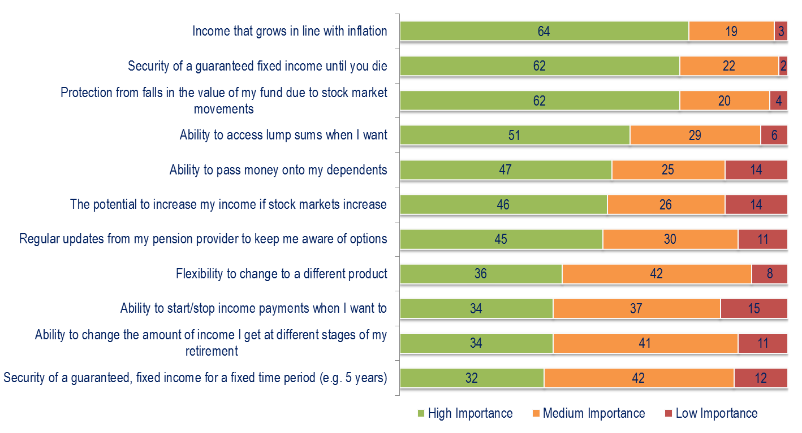
Consumer research
The most important features of a retirement product are protection against inflation, security of income
Q. What features are you looking for in a retirement product?

Slide 7
The retirement cycle…
ACCUMULATION
CONSOLIDATION
DECUMULATION
Considering issues and options
Planning for retirement
Managing throughout retirement
Retirement review
Retirement asset pool
Consolidating assets
Safeguarding saving propensity
CONSOLIDATION FOCUS
RETIREMENT INCOME FOCUS
Building up retirement assets
Income protection
Start saving
PHASE
Starting out | Mid life | Retiring soon | At Retirement | Early retirement years | Later retirement years
Notes:
Client journeys to retirement typically start a long time before retirement itself, and there are a number of key phases:
Saving towards retirement - the starting point. Thinking about how to spend retirement years, building up the funds needed to enjoy
retirement to the full, deciding on an investment strategy.
Consolidating their retirement position - the retirement review. Appraising retirement goals and saving plans, ‘tuning up’ their investment
strategy. Considering the needs of those that matter most.
Planning for retirement - the options. Understanding requirements in detail, making choices about retirement savings - for example, reducing
their exposure to investment risk.
Managing their chosen lifestyle throughout retirement. There’s the primetime retirement years - the living and then the later retirement years, possibly spent in poor health, even in care. Key considerations include maximising and sustaining income, fulfilling their lifestyle choices, cushioning against unforeseen issues and events.
Our sweet spot [mouse click]
We have considerable expertise in the pension consolidation and retirement income markets including pension accumulation, pension transfers, capped and flexible drawdown, enhanced and impaired lifetime annuities, fixed term annuities, investment-linked annuities and equity release.
With a clear focus on the pension consolidation and retirement income markets our Retirement Solutions business has seen significant growth since 2008 despite a challenging economic backdrop – we saw another increase in sales during 2013.
This success is built on the growing reputation of LV=’s life and pensions business offering a high level of service, with quality products, and competitive pricing.
So, on to our Personal Pension…

Slide 8
In the short term, those with flexibility during the transitional period will be winners, whilst standard annuities from vesting books and highly impaired cases will be the losers
Transitional products
Apr 2014
Apr 2015
Customer Priority:
Manage uncertainty
Optimise security/income trade-off
Age
65
66
Current (since March 27th ):
Fixed term annuity
New options
Previous:
Lifetime annuity
Despite this, many will continue to purchase annuities

Slide 9
In the longer-term…providing flexibility and breadth in an arena where retirement is no longer a single point

Slide 10
A new approach…
Retirement Income and Savings
ESSENTIALS HOPES RAINY DAYS
I must have this amount of money for life
A Guaranteed Minimum Income (Annuity)
I can take some risks with this money, probably want income
Investing for more income, with some risk (Drawdown)
A pot of money for emergencies / long term care
ISA / SAVINGS

Slide 11
The guidance guarantee…
Consumers want choice but are a little overwhelmed by the new choices they face. So guidance guarantee will help, but…
Will be delivered independently (TPAS, MAS)…but needs to remain independent with rules in place to prevent
Will be basic guidance…so needs to prompt action
Needs to ensure appropriate sign-posting to regulated advice: LV= has proposed appropriate regulated advice voucher
Increasing need for “pensions passport” to support consumer journey and replaced “wake up packs” to focus on consumer need, not arbitrary retirement date
Timescales are challenging… but exciting opportunity

Slide 12
Industry challenges…
Unique opportunity, but there will be winners and losers
Opportunity to communicate more clearly to consumers
Death benefits…potentially reduces the attractiveness of stand-alone annuities for consumers
Impact on bond markets…if individuals take pension cash and don’t invest
Potential greater demand for equity release (esp. those that exhaust pension) but…
Weakening in demand for annuities, invested in assets such as equity release, could limit this market and potentially trap wealth

Slide 13
Key challenges…
Consumers want these choices, but need help navigating them, otherwise could be worse off
Guidance needs to remain independent, prompt action and sign-post to regulated advice
Government/regulators need to consult better with consumer focused industry players
Timing is tight…but unique opportunity and industry needs to rise to the challenge
Need for greater pensions stability for pensions

Slide 14
John Perks, Managing Director, Retirement Solutions
14th October 2014

